Slide 1
Turbulence and its nonlinear cross-correlation analyses
Chijin Xiao
University of Saskatchewan
Notes:
number slides

Slide 2
Outline
Transport and anomalous transport
Biasing experiment on STOR-M
Conventional signal analyses (examples from STOR-M)
Nonlinear signal analyses
Algorithm
Numerical Validation
experiments on STOR-M
Experiments on TJ-II
Experiments on EAST
Other experiments?

Slide 3
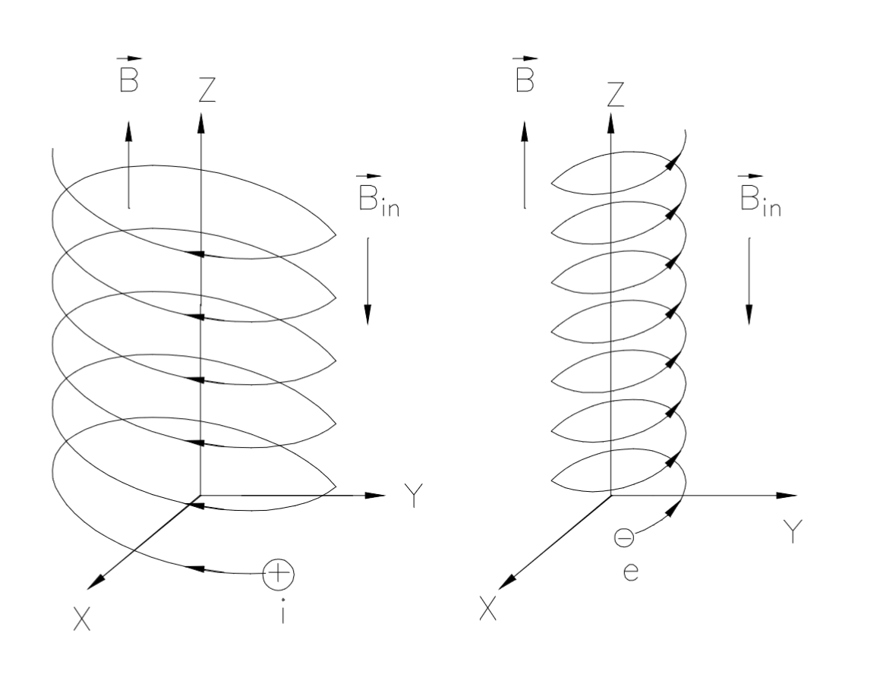
Transport
Charged particle motion in a uniform magnetic field
Confined by magnetic field lines with Larmor radius
Diamagnetic
Free to move along magnetic field lines
Notes:
What is a Reynolds Number?
Reynolds number is a dimensionless quantity that is used to determine the type of flow pattern as laminar or turbulent while flowing through a pipe. Reynolds number is defined by the ratio of inertial forces to that of viscous forces.
Reynolds Number Formula
It is given by the following relation:
$$R_e=Frac{\rho VD}{\mu}$$
Where,
R_{e} is the Reynolds number
ρ is the density of the fluid
V is the velocity of flow
D is the pipe diameter
μ is the viscosity of the fluid
If the Reynolds number calculated is high (greater than 2000), then the flow through the pipe is said to be turbulent. If Reynolds number is low (less than 2000), the flow is said to be laminar. Numerically, these are acceptable values, although in general the laminar and turbulent flows are classified according to a range. Laminar flow falls below Reynolds number of 1100 and turbulent falls in a range greater than 2200.
Laminar flow is the type of flow in which the fluid travels smoothly in regular paths. Conversely, turbulent flow isn’t smooth and follows an irregular math with lots of mixing.

Slide 4
Collison causes cross-field transport
Before collision
After collision
Radom walk step length:
Notes:
What is a Reynolds Number?
Reynolds number is a dimensionless quantity that is used to determine the type of flow pattern as laminar or turbulent while flowing through a pipe. Reynolds number is defined by the ratio of inertial forces to that of viscous forces.
Reynolds Number Formula
It is given by the following relation:
$$R_e=Frac{\rho VD}{\mu}$$
Where,
R_{e} is the Reynolds number
ρ is the density of the fluid
V is the velocity of flow
D is the pipe diameter
μ is the viscosity of the fluid
If the Reynolds number calculated is high (greater than 2000), then the flow through the pipe is said to be turbulent. If Reynolds number is low (less than 2000), the flow is said to be laminar. Numerically, these are acceptable values, although in general the laminar and turbulent flows are classified according to a range. Laminar flow falls below Reynolds number of 1100 and turbulent falls in a range greater than 2200.
Laminar flow is the type of flow in which the fluid travels smoothly in regular paths. Conversely, turbulent flow isn’t smooth and follows an irregular math with lots of mixing.

Slide 5
Fick’s Law and diffusion coefficient
Fick’s law:
Particles diffuse from high to low density region
The diffusion coefficient is
Notes:
What is a Reynolds Number?
Reynolds number is a dimensionless quantity that is used to determine the type of flow pattern as laminar or turbulent while flowing through a pipe. Reynolds number is defined by the ratio of inertial forces to that of viscous forces.
Reynolds Number Formula
It is given by the following relation:
$$R_e=Frac{\rho VD}{\mu}$$
Where,
R_{e} is the Reynolds number
ρ is the density of the fluid
V is the velocity of flow
D is the pipe diameter
μ is the viscosity of the fluid
If the Reynolds number calculated is high (greater than 2000), then the flow through the pipe is said to be turbulent. If Reynolds number is low (less than 2000), the flow is said to be laminar. Numerically, these are acceptable values, although in general the laminar and turbulent flows are classified according to a range. Laminar flow falls below Reynolds number of 1100 and turbulent falls in a range greater than 2200.
Laminar flow is the type of flow in which the fluid travels smoothly in regular paths. Conversely, turbulent flow isn’t smooth and follows an irregular math with lots of mixing.

Slide 6
Classical transport
Coulomb collision theory gives
Notes:
What is a Reynolds Number?
Reynolds number is a dimensionless quantity that is used to determine the type of flow pattern as laminar or turbulent while flowing through a pipe. Reynolds number is defined by the ratio of inertial forces to that of viscous forces.
Reynolds Number Formula
It is given by the following relation:
$$R_e=Frac{\rho VD}{\mu}$$
Where,
R_{e} is the Reynolds number
ρ is the density of the fluid
V is the velocity of flow
D is the pipe diameter
μ is the viscosity of the fluid
If the Reynolds number calculated is high (greater than 2000), then the flow through the pipe is said to be turbulent. If Reynolds number is low (less than 2000), the flow is said to be laminar. Numerically, these are acceptable values, although in general the laminar and turbulent flows are classified according to a range. Laminar flow falls below Reynolds number of 1100 and turbulent falls in a range greater than 2200.
Laminar flow is the type of flow in which the fluid travels smoothly in regular paths. Conversely, turbulent flow isn’t smooth and follows an irregular math with lots of mixing.

Slide 7
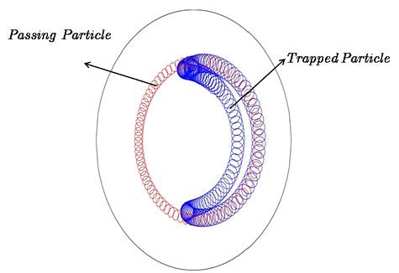
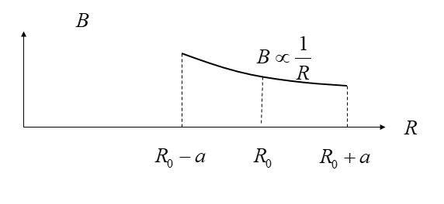
Neo-classical transport
Banana orbit is formed due to mirror effects in tokamaks:
Notes:
What is a Reynolds Number?
Reynolds number is a dimensionless quantity that is used to determine the type of flow pattern as laminar or turbulent while flowing through a pipe. Reynolds number is defined by the ratio of inertial forces to that of viscous forces.
Reynolds Number Formula
It is given by the following relation:
$$R_e=Frac{\rho VD}{\mu}$$
Where,
R_{e} is the Reynolds number
ρ is the density of the fluid
V is the velocity of flow
D is the pipe diameter
μ is the viscosity of the fluid
If the Reynolds number calculated is high (greater than 2000), then the flow through the pipe is said to be turbulent. If Reynolds number is low (less than 2000), the flow is said to be laminar. Numerically, these are acceptable values, although in general the laminar and turbulent flows are classified according to a range. Laminar flow falls below Reynolds number of 1100 and turbulent falls in a range greater than 2200.
Laminar flow is the type of flow in which the fluid travels smoothly in regular paths. Conversely, turbulent flow isn’t smooth and follows an irregular math with lots of mixing.

Slide 8
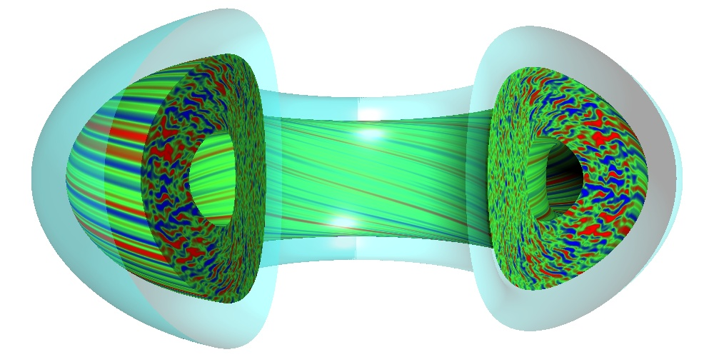
Anomalous transport
Anomalous transport is caused by turbulence
There is no theory for turbulence
Modeling and simulation reveals turbulence
Radom walk step length is now replaced by the turbulence eddy size
Anomalous transport exceeding classical transport is hindering fusion energy development
Notes:
What is a Reynolds Number?
Reynolds number is a dimensionless quantity that is used to determine the type of flow pattern as laminar or turbulent while flowing through a pipe. Reynolds number is defined by the ratio of inertial forces to that of viscous forces.
Reynolds Number Formula
It is given by the following relation:
$$R_e=Frac{\rho VD}{\mu}$$
Where,
R_{e} is the Reynolds number
ρ is the density of the fluid
V is the velocity of flow
D is the pipe diameter
μ is the viscosity of the fluid
If the Reynolds number calculated is high (greater than 2000), then the flow through the pipe is said to be turbulent. If Reynolds number is low (less than 2000), the flow is said to be laminar. Numerically, these are acceptable values, although in general the laminar and turbulent flows are classified according to a range. Laminar flow falls below Reynolds number of 1100 and turbulent falls in a range greater than 2200.
Laminar flow is the type of flow in which the fluid travels smoothly in regular paths. Conversely, turbulent flow isn’t smooth and follows an irregular math with lots of mixing.

Slide 9
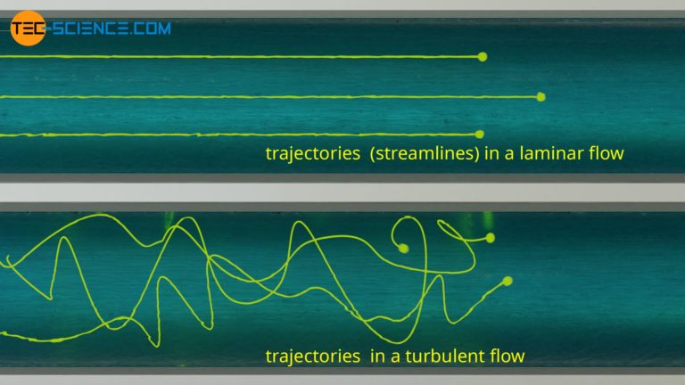
Laminar flow and turbulent flow
Laminar flow occur at low speed
Turbulent flow occurs at high speed with chaotic streamlines
Notes:
What is a Reynolds Number?
Reynolds number is a dimensionless quantity that is used to determine the type of flow pattern as laminar or turbulent while flowing through a pipe. Reynolds number is defined by the ratio of inertial forces to that of viscous forces.
Reynolds Number Formula
It is given by the following relation:
$$R_e=Frac{\rho VD}{\mu}$$
Where,
R_{e} is the Reynolds number
ρ is the density of the fluid
V is the velocity of flow
D is the pipe diameter
μ is the viscosity of the fluid
If the Reynolds number calculated is high (greater than 2000), then the flow through the pipe is said to be turbulent. If Reynolds number is low (less than 2000), the flow is said to be laminar. Numerically, these are acceptable values, although in general the laminar and turbulent flows are classified according to a range. Laminar flow falls below Reynolds number of 1100 and turbulent falls in a range greater than 2200.
Laminar flow is the type of flow in which the fluid travels smoothly in regular paths. Conversely, turbulent flow isn’t smooth and follows an irregular math with lots of mixing.

Slide 10
What causes turbulence?
Reynolds number
Turbulence occurs when
High flow velocity
Low viscosity
Notes:
What is a Reynolds Number?
Reynolds number is a dimensionless quantity that is used to determine the type of flow pattern as laminar or turbulent while flowing through a pipe. Reynolds number is defined by the ratio of inertial forces to that of viscous forces.
Reynolds Number Formula
It is given by the following relation:
$$R_e=Frac{\rho VD}{\mu}$$
Where,
R_{e} is the Reynolds number
ρ is the density of the fluid
V is the velocity of flow
D is the pipe diameter
μ is the viscosity of the fluid
If the Reynolds number calculated is high (greater than 2000), then the flow through the pipe is said to be turbulent. If Reynolds number is low (less than 2000), the flow is said to be laminar. Numerically, these are acceptable values, although in general the laminar and turbulent flows are classified according to a range. Laminar flow falls below Reynolds number of 1100 and turbulent falls in a range greater than 2200.
Laminar flow is the type of flow in which the fluid travels smoothly in regular paths. Conversely, turbulent flow isn’t smooth and follows an irregular math with lots of mixing.

Slide 11
Drift type instabilities
Cross field drift
In addition to magnetic force , another force is added
This causes a drift perpendicular to both the force and the magnetic field
Notes:
What is a Reynolds Number?
Reynolds number is a dimensionless quantity that is used to determine the type of flow pattern as laminar or turbulent while flowing through a pipe. Reynolds number is defined by the ratio of inertial forces to that of viscous forces.
Reynolds Number Formula
It is given by the following relation:
$$R_e=Frac{\rho VD}{\mu}$$
Where,
R_{e} is the Reynolds number
ρ is the density of the fluid
V is the velocity of flow
D is the pipe diameter
μ is the viscosity of the fluid
If the Reynolds number calculated is high (greater than 2000), then the flow through the pipe is said to be turbulent. If Reynolds number is low (less than 2000), the flow is said to be laminar. Numerically, these are acceptable values, although in general the laminar and turbulent flows are classified according to a range. Laminar flow falls below Reynolds number of 1100 and turbulent falls in a range greater than 2200.
Laminar flow is the type of flow in which the fluid travels smoothly in regular paths. Conversely, turbulent flow isn’t smooth and follows an irregular math with lots of mixing.

Slide 12
drift in tokamaks
Radial electric force (assumed inwards)
Notes:
What is a Reynolds Number?
Reynolds number is a dimensionless quantity that is used to determine the type of flow pattern as laminar or turbulent while flowing through a pipe. Reynolds number is defined by the ratio of inertial forces to that of viscous forces.
Reynolds Number Formula
It is given by the following relation:
$$R_e=Frac{\rho VD}{\mu}$$
Where,
R_{e} is the Reynolds number
ρ is the density of the fluid
V is the velocity of flow
D is the pipe diameter
μ is the viscosity of the fluid
If the Reynolds number calculated is high (greater than 2000), then the flow through the pipe is said to be turbulent. If Reynolds number is low (less than 2000), the flow is said to be laminar. Numerically, these are acceptable values, although in general the laminar and turbulent flows are classified according to a range. Laminar flow falls below Reynolds number of 1100 and turbulent falls in a range greater than 2200.
Laminar flow is the type of flow in which the fluid travels smoothly in regular paths. Conversely, turbulent flow isn’t smooth and follows an irregular math with lots of mixing.

Slide 13
Pressure Gradient Drift
Pressure force per particle
Charge dependent drift direction
Electron (ion) drift direction
Diamagnetic drift
Notes:
What is a Reynolds Number?
Reynolds number is a dimensionless quantity that is used to determine the type of flow pattern as laminar or turbulent while flowing through a pipe. Reynolds number is defined by the ratio of inertial forces to that of viscous forces.
Reynolds Number Formula
It is given by the following relation:
$$R_e=Frac{\rho VD}{\mu}$$
Where,
R_{e} is the Reynolds number
ρ is the density of the fluid
V is the velocity of flow
D is the pipe diameter
μ is the viscosity of the fluid
If the Reynolds number calculated is high (greater than 2000), then the flow through the pipe is said to be turbulent. If Reynolds number is low (less than 2000), the flow is said to be laminar. Numerically, these are acceptable values, although in general the laminar and turbulent flows are classified according to a range. Laminar flow falls below Reynolds number of 1100 and turbulent falls in a range greater than 2200.
Laminar flow is the type of flow in which the fluid travels smoothly in regular paths. Conversely, turbulent flow isn’t smooth and follows an irregular math with lots of mixing.

Slide 14
Radial Force Balance
Force equation
Notes:
What is a Reynolds Number?
Reynolds number is a dimensionless quantity that is used to determine the type of flow pattern as laminar or turbulent while flowing through a pipe. Reynolds number is defined by the ratio of inertial forces to that of viscous forces.
Reynolds Number Formula
It is given by the following relation:
$$R_e=Frac{\rho VD}{\mu}$$
Where,
R_{e} is the Reynolds number
ρ is the density of the fluid
V is the velocity of flow
D is the pipe diameter
μ is the viscosity of the fluid
If the Reynolds number calculated is high (greater than 2000), then the flow through the pipe is said to be turbulent. If Reynolds number is low (less than 2000), the flow is said to be laminar. Numerically, these are acceptable values, although in general the laminar and turbulent flows are classified according to a range. Laminar flow falls below Reynolds number of 1100 and turbulent falls in a range greater than 2200.
Laminar flow is the type of flow in which the fluid travels smoothly in regular paths. Conversely, turbulent flow isn’t smooth and follows an irregular math with lots of mixing.

Slide 15
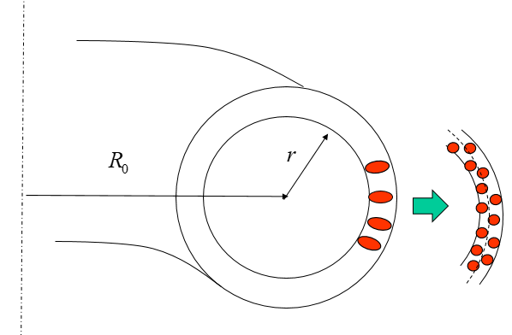
Turbulence Eddy Breakup
Electrode biasing generate an flow shear
Breaks up the turbulence eddies to smaller ones and improves the confinement
Notes:
What is a Reynolds Number?
Reynolds number is a dimensionless quantity that is used to determine the type of flow pattern as laminar or turbulent while flowing through a pipe. Reynolds number is defined by the ratio of inertial forces to that of viscous forces.
Reynolds Number Formula
It is given by the following relation:
$$R_e=Frac{\rho VD}{\mu}$$
Where,
R_{e} is the Reynolds number
ρ is the density of the fluid
V is the velocity of flow
D is the pipe diameter
μ is the viscosity of the fluid
If the Reynolds number calculated is high (greater than 2000), then the flow through the pipe is said to be turbulent. If Reynolds number is low (less than 2000), the flow is said to be laminar. Numerically, these are acceptable values, although in general the laminar and turbulent flows are classified according to a range. Laminar flow falls below Reynolds number of 1100 and turbulent falls in a range greater than 2200.
Laminar flow is the type of flow in which the fluid travels smoothly in regular paths. Conversely, turbulent flow isn’t smooth and follows an irregular math with lots of mixing.

Slide 16
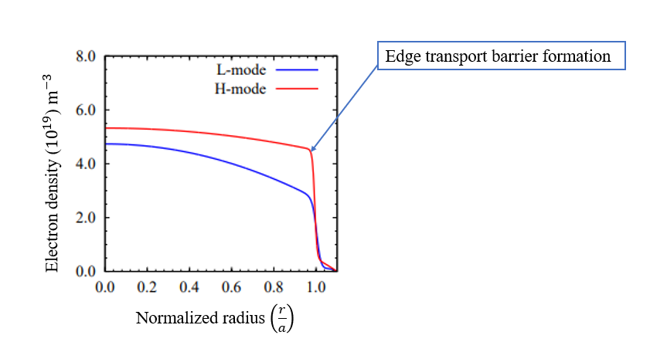
Pedestal Formation
Helps to generate a poloidal flow shear
Breaks up the turbulence eddies and improves the confinement
Notes:
What is a Reynolds Number?
Reynolds number is a dimensionless quantity that is used to determine the type of flow pattern as laminar or turbulent while flowing through a pipe. Reynolds number is defined by the ratio of inertial forces to that of viscous forces.
Reynolds Number Formula
It is given by the following relation:
$$R_e=Frac{\rho VD}{\mu}$$
Where,
R_{e} is the Reynolds number
ρ is the density of the fluid
V is the velocity of flow
D is the pipe diameter
μ is the viscosity of the fluid
If the Reynolds number calculated is high (greater than 2000), then the flow through the pipe is said to be turbulent. If Reynolds number is low (less than 2000), the flow is said to be laminar. Numerically, these are acceptable values, although in general the laminar and turbulent flows are classified according to a range. Laminar flow falls below Reynolds number of 1100 and turbulent falls in a range greater than 2200.
Laminar flow is the type of flow in which the fluid travels smoothly in regular paths. Conversely, turbulent flow isn’t smooth and follows an irregular math with lots of mixing.

Slide 17
Outline
Transport and anomalous transport
Biasing experiments on STOR-M
Conventional signal analyses (examples from STOR-M)
Nonlinear signal analyses
Algorithm
Numerical Validation
experiments on STOR-M
Experiments on TJ-II
Experiments on EAST
Other experiments?

Slide 18
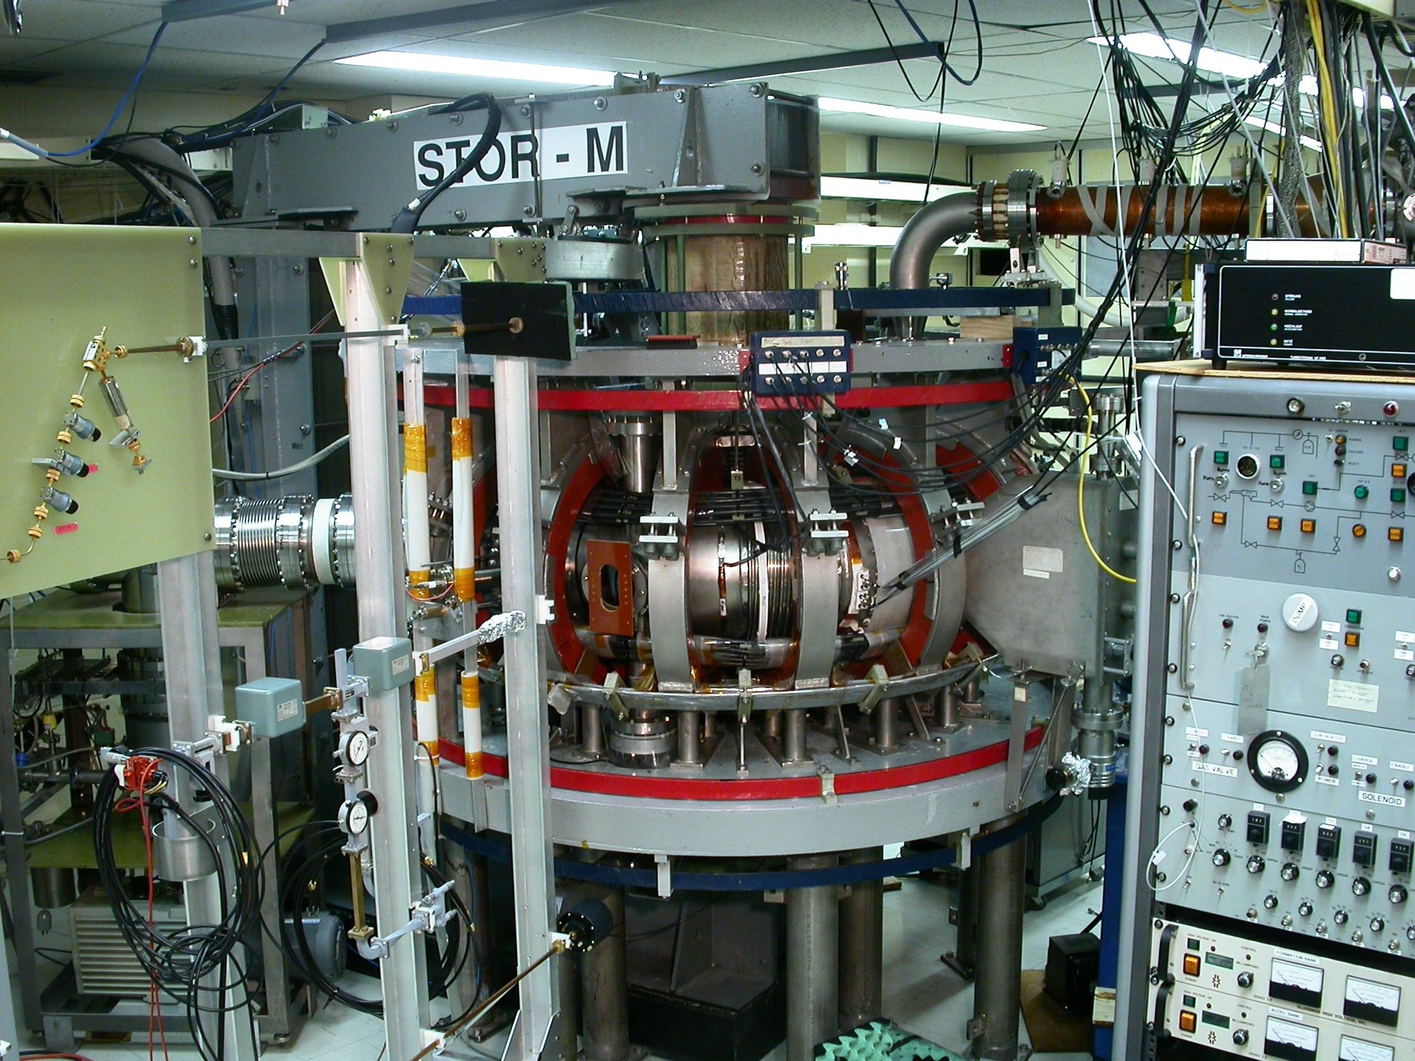
STOR-M
Construction started in 1984
Operational since 1987
Still active as the only tokamak in Canada

Slide 19
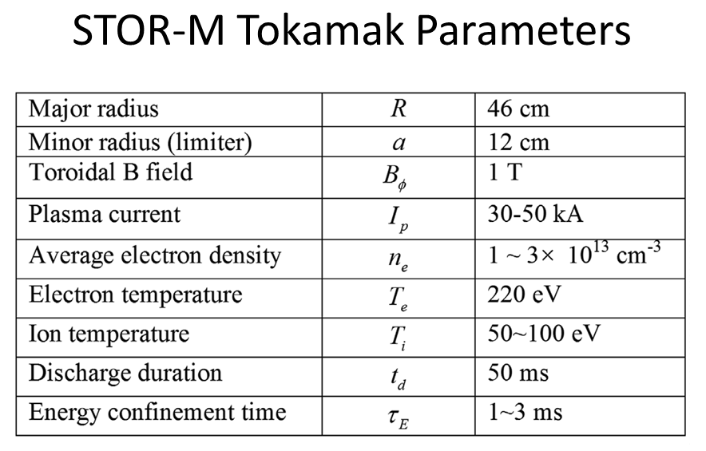
20-30 kA

Slide 20
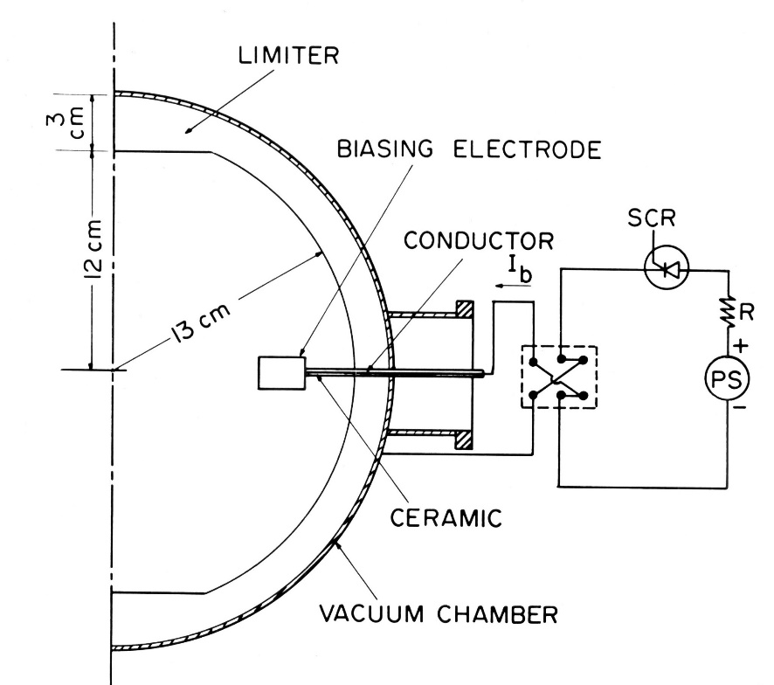
Electrode Biasing Experiments
DC Biasing
Notes:
What is a Reynolds Number?
Reynolds number is a dimensionless quantity that is used to determine the type of flow pattern as laminar or turbulent while flowing through a pipe. Reynolds number is defined by the ratio of inertial forces to that of viscous forces.
Reynolds Number Formula
It is given by the following relation:
$$R_e=Frac{\rho VD}{\mu}$$
Where,
R_{e} is the Reynolds number
ρ is the density of the fluid
V is the velocity of flow
D is the pipe diameter
μ is the viscosity of the fluid
If the Reynolds number calculated is high (greater than 2000), then the flow through the pipe is said to be turbulent. If Reynolds number is low (less than 2000), the flow is said to be laminar. Numerically, these are acceptable values, although in general the laminar and turbulent flows are classified according to a range. Laminar flow falls below Reynolds number of 1100 and turbulent falls in a range greater than 2200.
Laminar flow is the type of flow in which the fluid travels smoothly in regular paths. Conversely, turbulent flow isn’t smooth and follows an irregular math with lots of mixing.

Slide 21
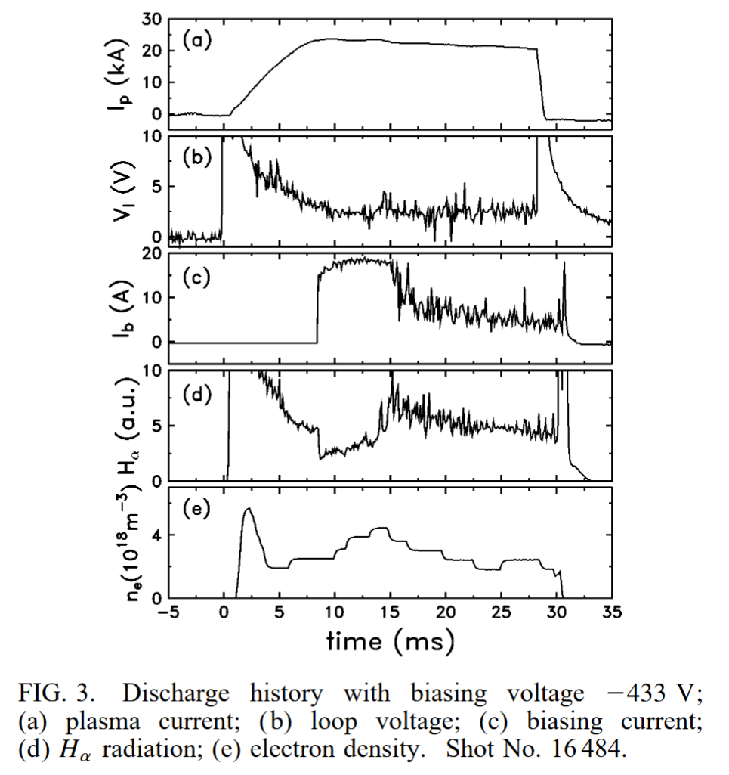
Transient Ohmic H-Mode
Notes:
What is a Reynolds Number?
Reynolds number is a dimensionless quantity that is used to determine the type of flow pattern as laminar or turbulent while flowing through a pipe. Reynolds number is defined by the ratio of inertial forces to that of viscous forces.
Reynolds Number Formula
It is given by the following relation:
$$R_e=Frac{\rho VD}{\mu}$$
Where,
R_{e} is the Reynolds number
ρ is the density of the fluid
V is the velocity of flow
D is the pipe diameter
μ is the viscosity of the fluid
If the Reynolds number calculated is high (greater than 2000), then the flow through the pipe is said to be turbulent. If Reynolds number is low (less than 2000), the flow is said to be laminar. Numerically, these are acceptable values, although in general the laminar and turbulent flows are classified according to a range. Laminar flow falls below Reynolds number of 1100 and turbulent falls in a range greater than 2200.
Laminar flow is the type of flow in which the fluid travels smoothly in regular paths. Conversely, turbulent flow isn’t smooth and follows an irregular math with lots of mixing.

Slide 22
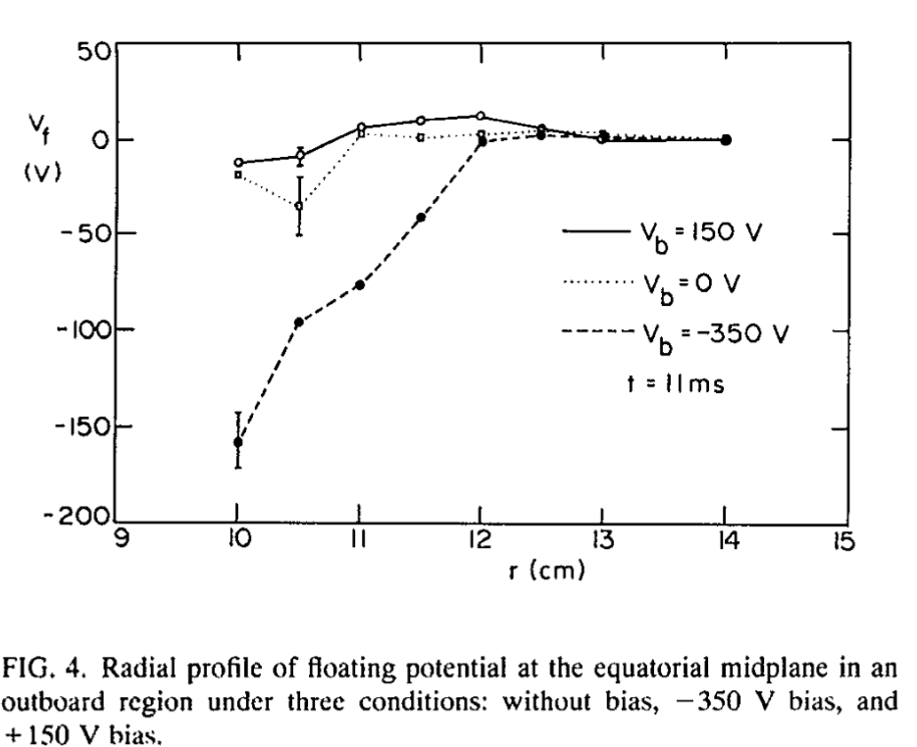
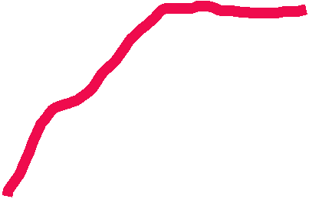
Modification of floating potential
Notes:
What is a Reynolds Number?
Reynolds number is a dimensionless quantity that is used to determine the type of flow pattern as laminar or turbulent while flowing through a pipe. Reynolds number is defined by the ratio of inertial forces to that of viscous forces.
Reynolds Number Formula
It is given by the following relation:
$$R_e=Frac{\rho VD}{\mu}$$
Where,
R_{e} is the Reynolds number
ρ is the density of the fluid
V is the velocity of flow
D is the pipe diameter
μ is the viscosity of the fluid
If the Reynolds number calculated is high (greater than 2000), then the flow through the pipe is said to be turbulent. If Reynolds number is low (less than 2000), the flow is said to be laminar. Numerically, these are acceptable values, although in general the laminar and turbulent flows are classified according to a range. Laminar flow falls below Reynolds number of 1100 and turbulent falls in a range greater than 2200.
Laminar flow is the type of flow in which the fluid travels smoothly in regular paths. Conversely, turbulent flow isn’t smooth and follows an irregular math with lots of mixing.

Slide 23
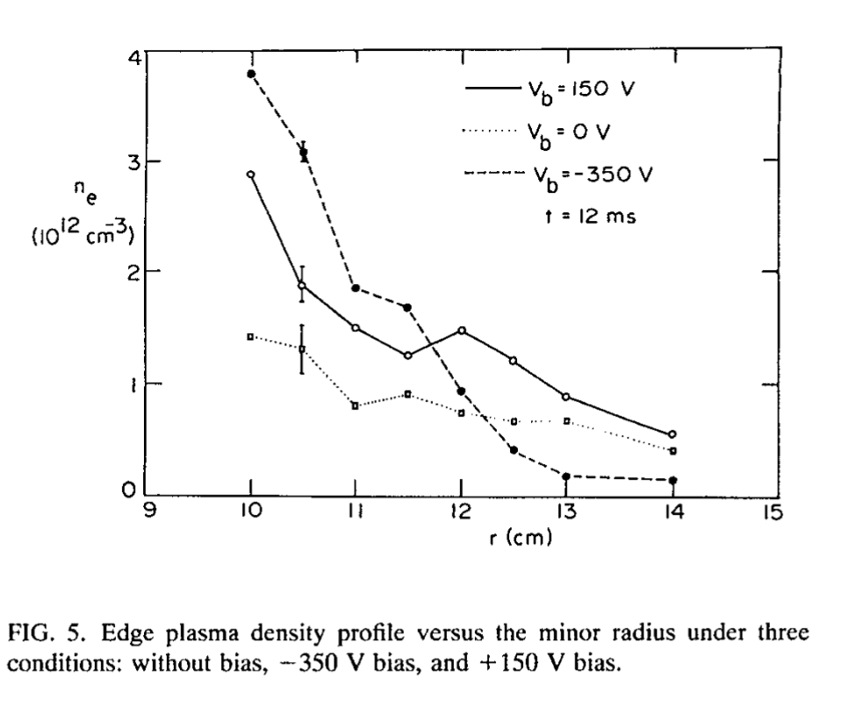
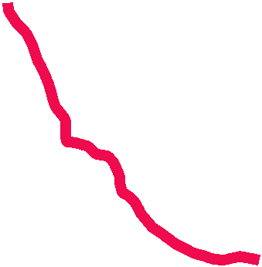
Modification of Density Profile
Notes:
What is a Reynolds Number?
Reynolds number is a dimensionless quantity that is used to determine the type of flow pattern as laminar or turbulent while flowing through a pipe. Reynolds number is defined by the ratio of inertial forces to that of viscous forces.
Reynolds Number Formula
It is given by the following relation:
$$R_e=Frac{\rho VD}{\mu}$$
Where,
R_{e} is the Reynolds number
ρ is the density of the fluid
V is the velocity of flow
D is the pipe diameter
μ is the viscosity of the fluid
If the Reynolds number calculated is high (greater than 2000), then the flow through the pipe is said to be turbulent. If Reynolds number is low (less than 2000), the flow is said to be laminar. Numerically, these are acceptable values, although in general the laminar and turbulent flows are classified according to a range. Laminar flow falls below Reynolds number of 1100 and turbulent falls in a range greater than 2200.
Laminar flow is the type of flow in which the fluid travels smoothly in regular paths. Conversely, turbulent flow isn’t smooth and follows an irregular math with lots of mixing.

Slide 24
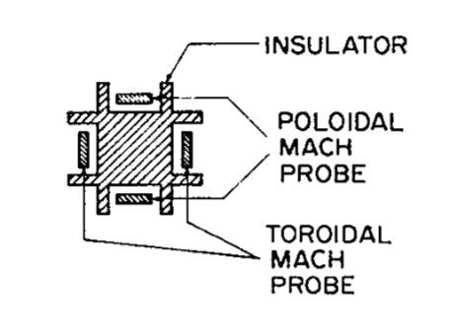
Mach Probe
Four-sided Mach probe
Notes:
What is a Reynolds Number?
Reynolds number is a dimensionless quantity that is used to determine the type of flow pattern as laminar or turbulent while flowing through a pipe. Reynolds number is defined by the ratio of inertial forces to that of viscous forces.
Reynolds Number Formula
It is given by the following relation:
$$R_e=Frac{\rho VD}{\mu}$$
Where,
R_{e} is the Reynolds number
ρ is the density of the fluid
V is the velocity of flow
D is the pipe diameter
μ is the viscosity of the fluid
If the Reynolds number calculated is high (greater than 2000), then the flow through the pipe is said to be turbulent. If Reynolds number is low (less than 2000), the flow is said to be laminar. Numerically, these are acceptable values, although in general the laminar and turbulent flows are classified according to a range. Laminar flow falls below Reynolds number of 1100 and turbulent falls in a range greater than 2200.
Laminar flow is the type of flow in which the fluid travels smoothly in regular paths. Conversely, turbulent flow isn’t smooth and follows an irregular math with lots of mixing.

Slide 25
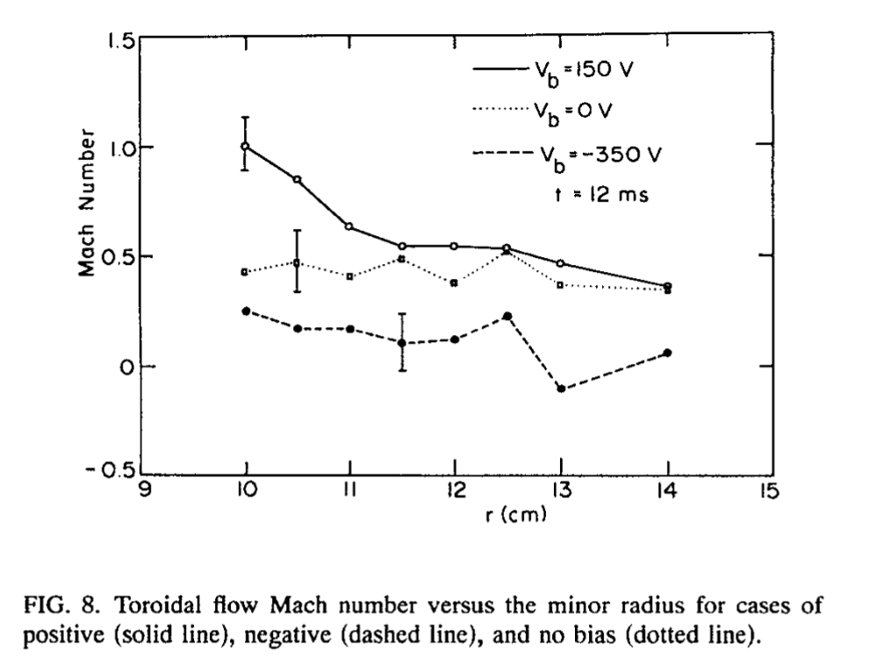


Toroidal Flow
Notes:
What is a Reynolds Number?
Reynolds number is a dimensionless quantity that is used to determine the type of flow pattern as laminar or turbulent while flowing through a pipe. Reynolds number is defined by the ratio of inertial forces to that of viscous forces.
Reynolds Number Formula
It is given by the following relation:
$$R_e=Frac{\rho VD}{\mu}$$
Where,
R_{e} is the Reynolds number
ρ is the density of the fluid
V is the velocity of flow
D is the pipe diameter
μ is the viscosity of the fluid
If the Reynolds number calculated is high (greater than 2000), then the flow through the pipe is said to be turbulent. If Reynolds number is low (less than 2000), the flow is said to be laminar. Numerically, these are acceptable values, although in general the laminar and turbulent flows are classified according to a range. Laminar flow falls below Reynolds number of 1100 and turbulent falls in a range greater than 2200.
Laminar flow is the type of flow in which the fluid travels smoothly in regular paths. Conversely, turbulent flow isn’t smooth and follows an irregular math with lots of mixing.

Slide 26
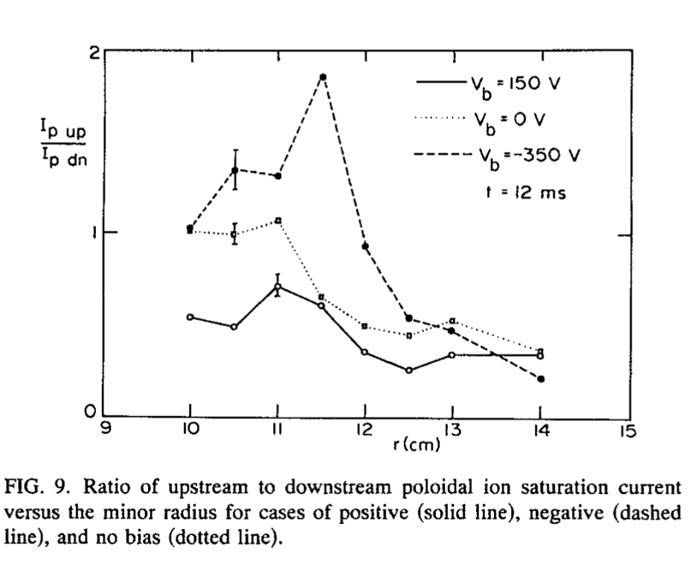
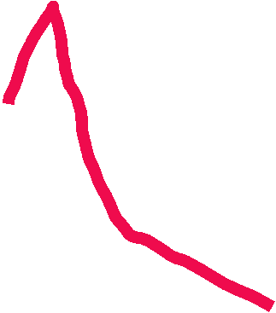
Poloidal Flow
Notes:
What is a Reynolds Number?
Reynolds number is a dimensionless quantity that is used to determine the type of flow pattern as laminar or turbulent while flowing through a pipe. Reynolds number is defined by the ratio of inertial forces to that of viscous forces.
Reynolds Number Formula
It is given by the following relation:
$$R_e=Frac{\rho VD}{\mu}$$
Where,
R_{e} is the Reynolds number
ρ is the density of the fluid
V is the velocity of flow
D is the pipe diameter
μ is the viscosity of the fluid
If the Reynolds number calculated is high (greater than 2000), then the flow through the pipe is said to be turbulent. If Reynolds number is low (less than 2000), the flow is said to be laminar. Numerically, these are acceptable values, although in general the laminar and turbulent flows are classified according to a range. Laminar flow falls below Reynolds number of 1100 and turbulent falls in a range greater than 2200.
Laminar flow is the type of flow in which the fluid travels smoothly in regular paths. Conversely, turbulent flow isn’t smooth and follows an irregular math with lots of mixing.

Slide 27
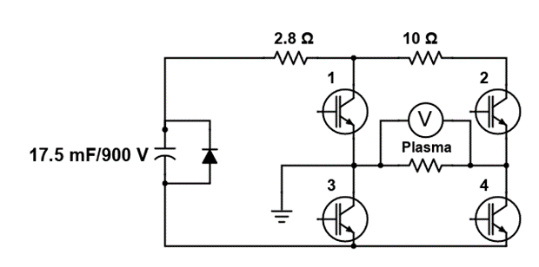
Other Biasing Waveforms
FPGA controlled H-bridge
Programable bipolar pulses

Slide 28
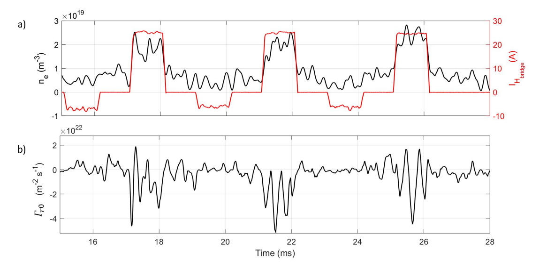
Bipolar Biasing
Modified density
Modified particle flux

Slide 29
Outline
Transport and anomalous transport
Biasing experiment on STOR-M
Conventional signal analyses (examples from STOR-M)
Nonlinear signal analyses
Algorithm
Numerical Validation
experiments on STOR-M
Experiments on TJ-II
Experiments on EAST

Slide 30
Conventional Signal Analyses
Auto- and cross-correlation (time domain)
Time scale and spatial spread of turbulence eddies
Phase propagation direction and velocity
FFT analyses (frequency domain) or wavelet
Power spectra (magnitude only)
Phase propagation direction
Coherence (strength only)
Bicoherence
Mode coupling strength (no directions)

Slide 31
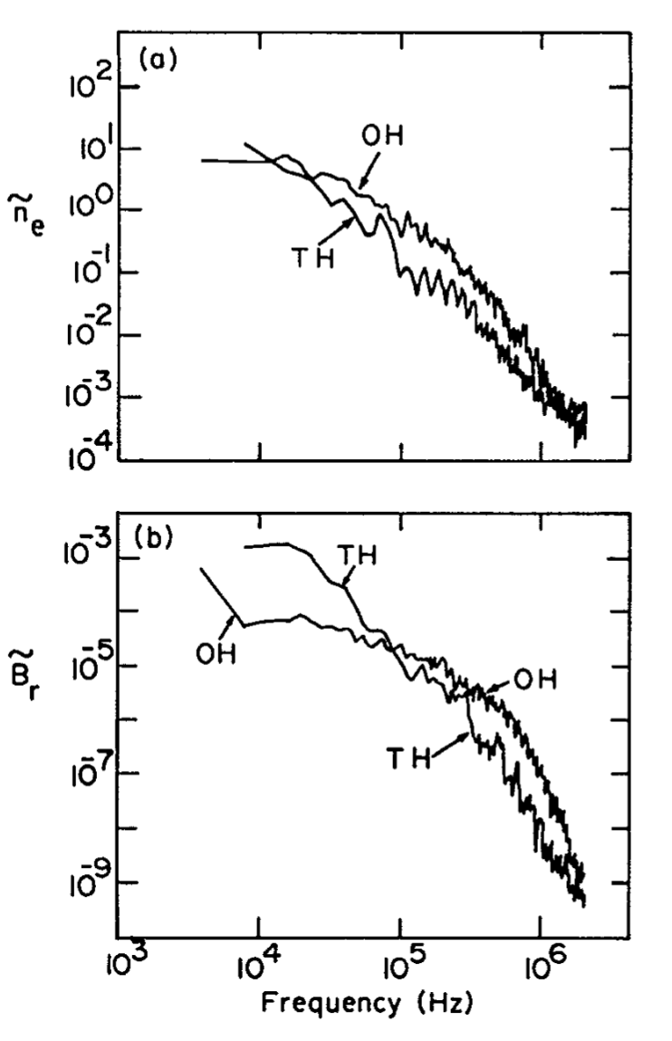
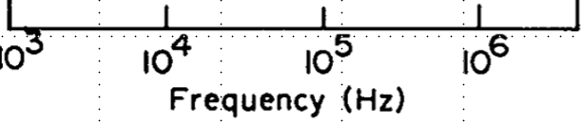
Power Spectra of Fluctuations
FFT (DFT)
Broad band
Different slopes in low and high frequency ranges

Slide 32
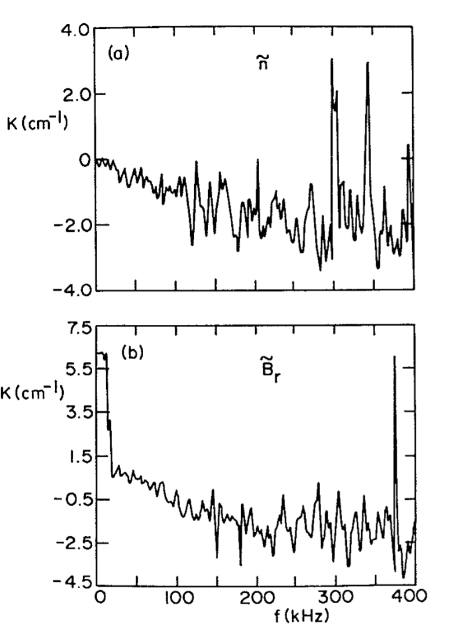

Dispersion Relation
Phase difference of two probes separated in space (poloidal for the case below)

Slide 33
Outline
Transport and anomalous transport
Biasing experiment in STOR-M
Conventional signal analyses (examples from STOR-M)
Nonlinear signal analyses
Algorithm
Numerical Validation
Experiments on STOR-M
Experiments on TJ-II
Experiments on EAST
Other experiments?

Slide 34
Nonlinear Cross-Correlation
Plasma is governed by nonlinear equations
Solutions are not unique
Solutions are sensitive to plasma parameters, initial/boundary conditions, perturbations
Jumping between solutions (H-L-H transitions)
Chaotic or self-organized system
A different method may be used to reveal turbulence energy propagation direction

Slide 35
Conditional nonlinear cross-correlation
Complex nonlinear (chaotic) systems (in multi-dimensional phase space)
Self-Organized Critical (SOC) systems
Bifurcation of chaotic systems and formation of attractors (L-H transition)
Examples:
Transfer Entropy (B.Ph. van Milligen, et al. NF 54 (2014) 023011) - entropy (energy) transport direction
Our algorithm (W. X. Ding, et al. PRL 79 (1997) 2458)

Slide 36
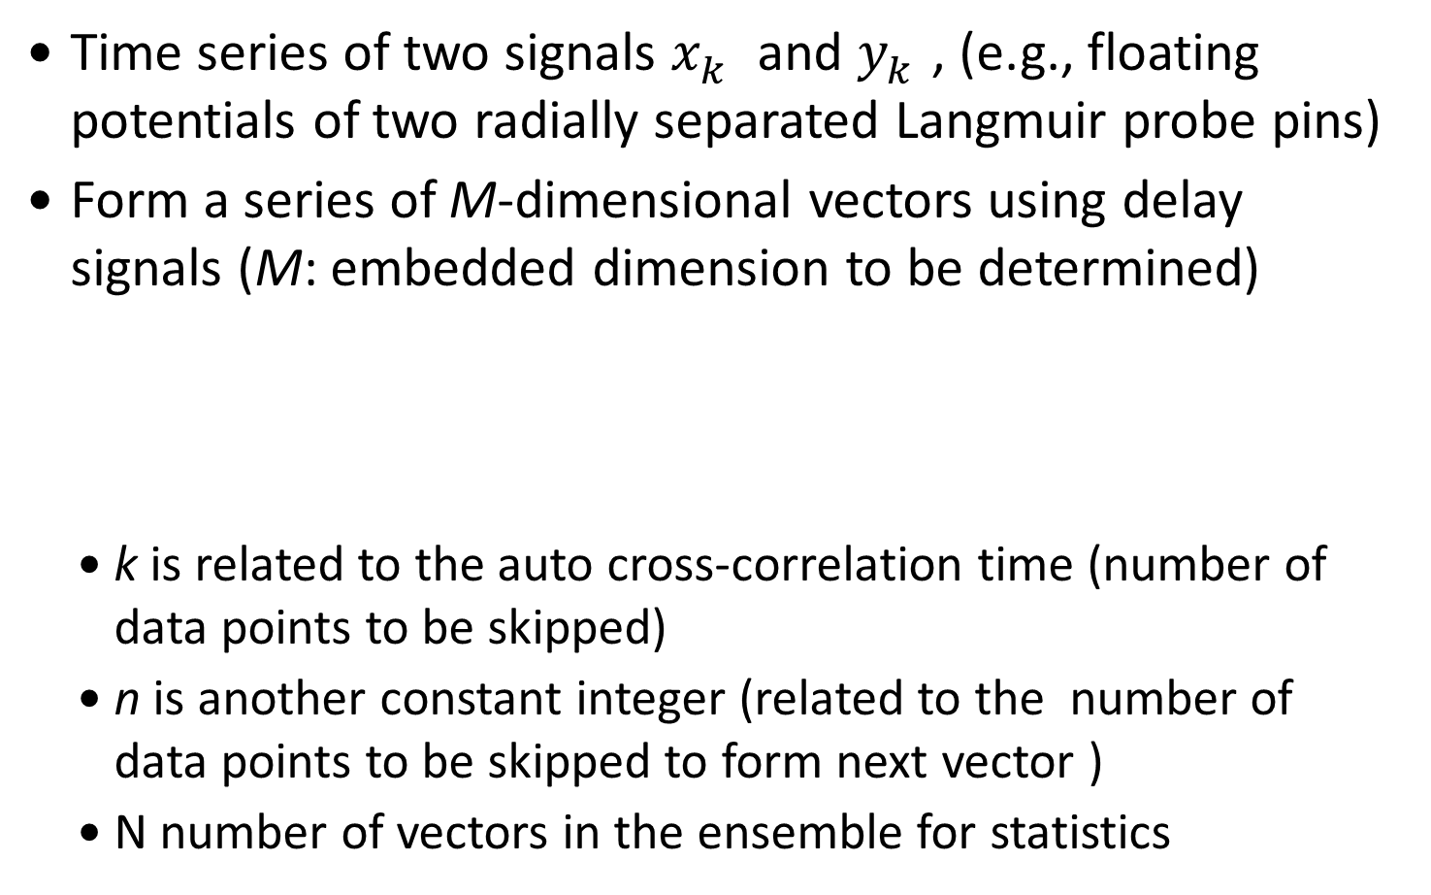
Algorithm
Time series of two signals $x_{k}^{}$ and $y_{k}^{}$, (e.g., floating potentials of two radially separated Langmuir probe pins)
Form a series of M-dimensional vectors using delay signals (M: embedded dimension to be determined)
k is related to the auto cross-correlation time (number of data points to be skipped)
n is another constant integer (related to the number of data points to be skipped to form next vector )
N number of vectors in the ensemble for statistics

Slide 37
 | 3 | 4 | 5 | 6 | 7 | 8 | 9 | 10 | 11 | 12
13 | 14

Slide 38
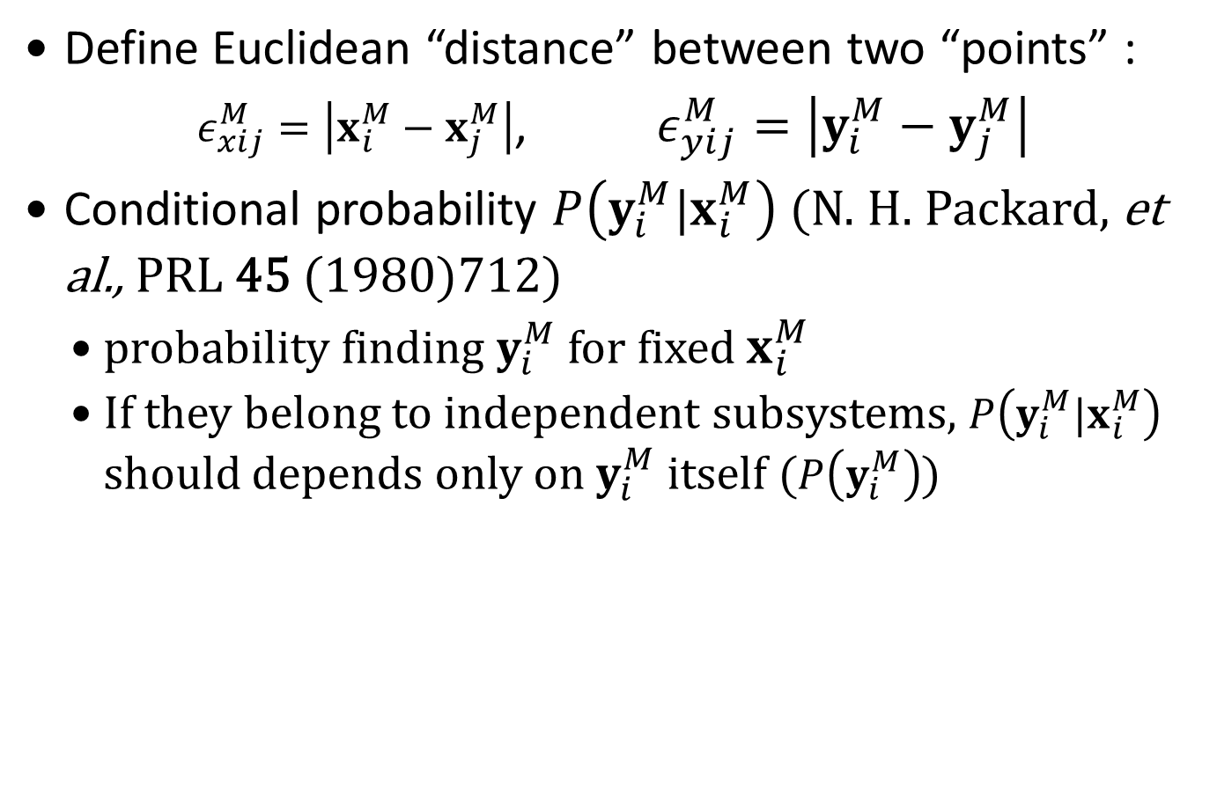
Algorithm
Define Euclidean “distance” between two “points” :
$ε_{xij}^{M}=\left|x_{i}^{M}−x_{j}^{M}\right|$, $ε_{yij}^{M}=\left|y_{i}^{M}−y_{j}^{M}\right|$
Conditional probability $P\left({y_{i}^{M}|x}_{i}^{M}\right)$ (N. H. Packard, et al., PRL 45 (1980)712)
$probability$finding $y_{i}^{M}$ for fixed $x_{i}^{M}$
If they belong to independent subsystems, $P\left({y_{i}^{M}|x}_{i}^{M}\right)$ should depends only on $y_{i}^{M}$ itself ($P\left(y_{i}^{M}\right)$)

Slide 39

Algorithm
Mean conditional dispersion
$σ_{xy}^{M}(ε)=\sqrt{\frac{\sum_{i≠j}{{\left|y_{i}^{M}−y_{j}^{M}\right|}^{2}H\left(ε−\left|x_{i}^{M}−x_{j}^{M}\right|\right)}}{\sum_{i≠j}{H\left(ε−\left|x_{i}^{M}−x_{j}^{M}\right|\right)}}}$,
where H is the Heaviside function

Slide 40
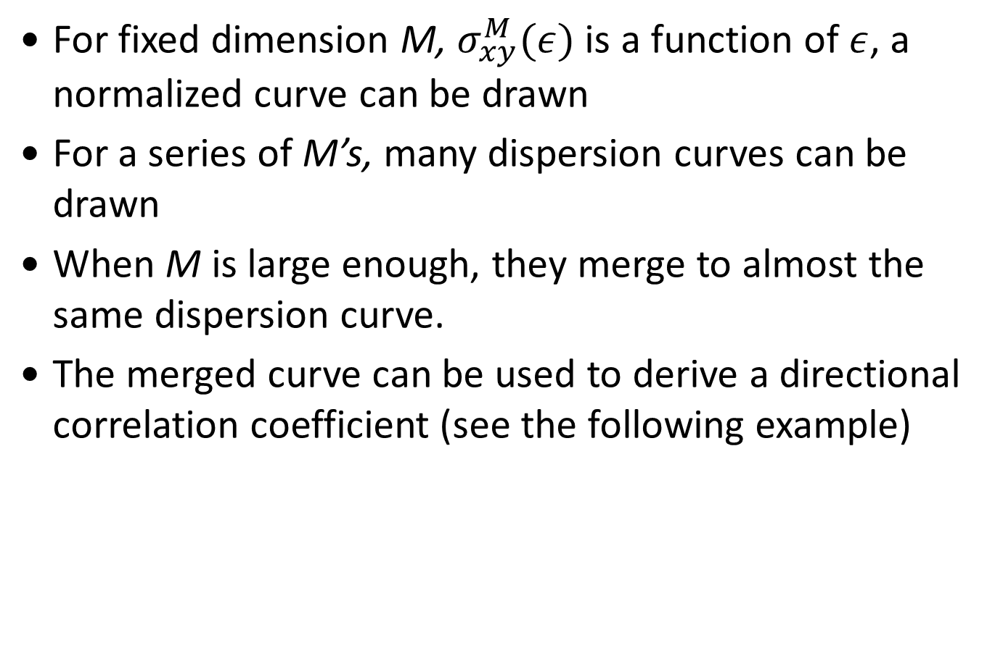
Algorithm
For fixed dimension M, $σ_{xy}^{M}(ε)$ is a function of $ε$, a normalized curve can be drawn
For a series of M’s, many dispersion curves can be drawn
When M is large enough, they merge to almost the same dispersion curve.
The merged curve can be used to derive a directional correlation coefficient (see the following example)

Slide 41
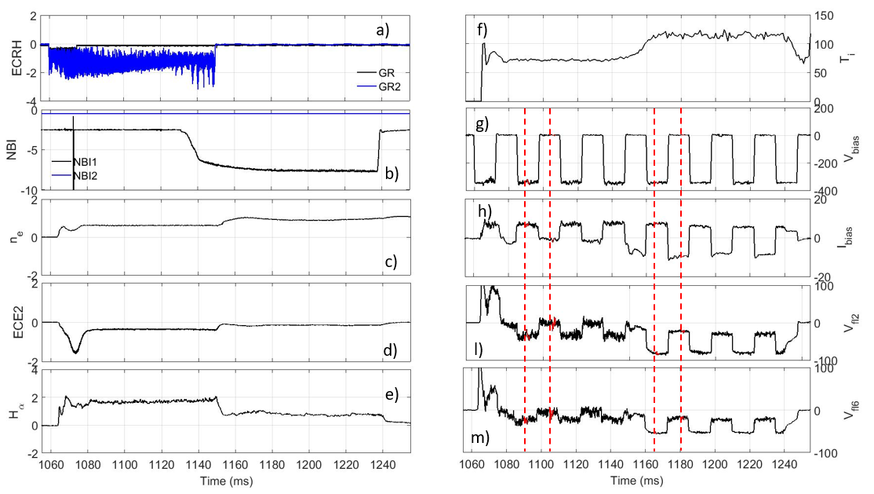
Sample data (dispersion curves )
TJ-II discharge #43823 with electrode biasing pulses (-350 V)

Slide 42
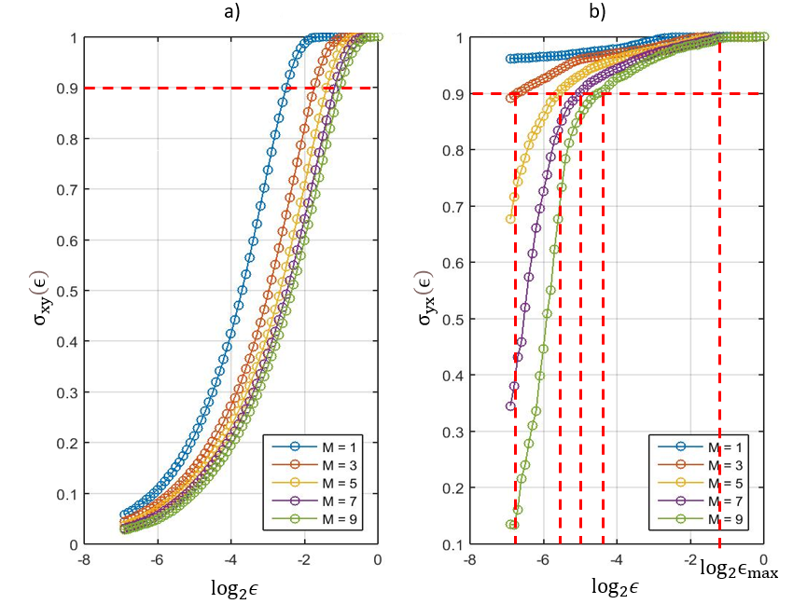
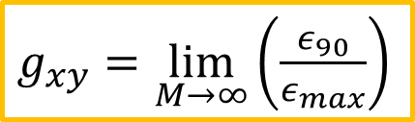

Sample data
and correlation coefficient
Dispersion relation
$g_{xy}=\lim_{M→∞}\left(\frac{ε_{90}}{ε_{max}}\right)$
Similarly, find also $g_{yx}$
The asymmetry determines the energy propagation direction
$g_{xy}$> $g_{yx}$: propagate from x to y
$g_{yx}$>$g_{xy}$ : propagate from y to x

Slide 43
Algorithm
Correlation asymmetry
Nonlinear cross-correlation direction

Slide 44
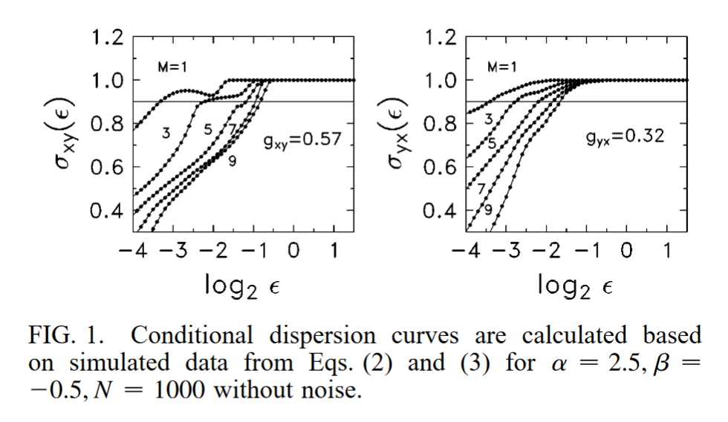
Numerical Validation
Van der Pol coupled oscillators

Slide 45
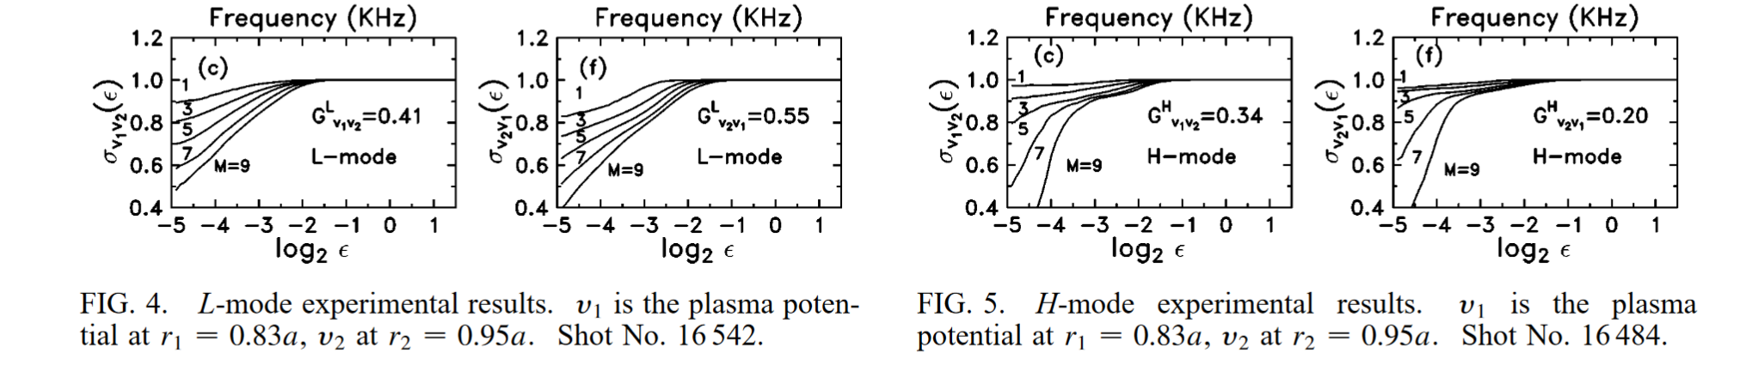
Electrode biasing triggered ohmic H-mode in STOR-M

Slide 46
Electrode biasing triggered ohmic H-mode in STOR-M

Slide 47
Outline
Transport and anomalous transport
Biasing experiment in STOR-M
Conventional signal analyses (examples from STOR-M)
Nonlinear signal analyses
Algorithm
Numerical Validation
experiments on STOR-M
Experiments on TJ-II
Experiments on EAST
Other experiments?

Slide 48
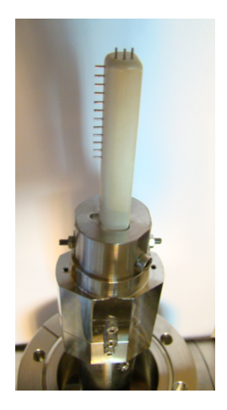
TJ-II experiments
TJ-II (stellarators)
Medium size, well diagnosed device, good machine time accessibility
Lots of existing data already analyzed by different techniques
Top D-port

Slide 49
Experiments on TJ-II
Continuous bipolar pulsed electrode biasing
(-350 V, 0, +150V, 10 ms each voltage)
Constant DC voltages
Stationary rake probe (top D port) with flux measurement on the tip
ECRH and NBI heated plasma
Data obtained

Slide 50
Experiments on TJ-II
Other spatially resolved fluctuation data can be downloaded as well
ECE (temperature)
HIBP (Potential, temperature)
Magnetic probes

Slide 51
Outline
Transport and anomalous transport
Biasing experiment in STOR-M
Conventional signal analyses (examples from STOR-M)
Nonlinear signal analyses
Algorithm
Numerical Validation
experiments on STOR-M
Experiments on TJ-II
Experiments on EAST
Other experiments?

Slide 52
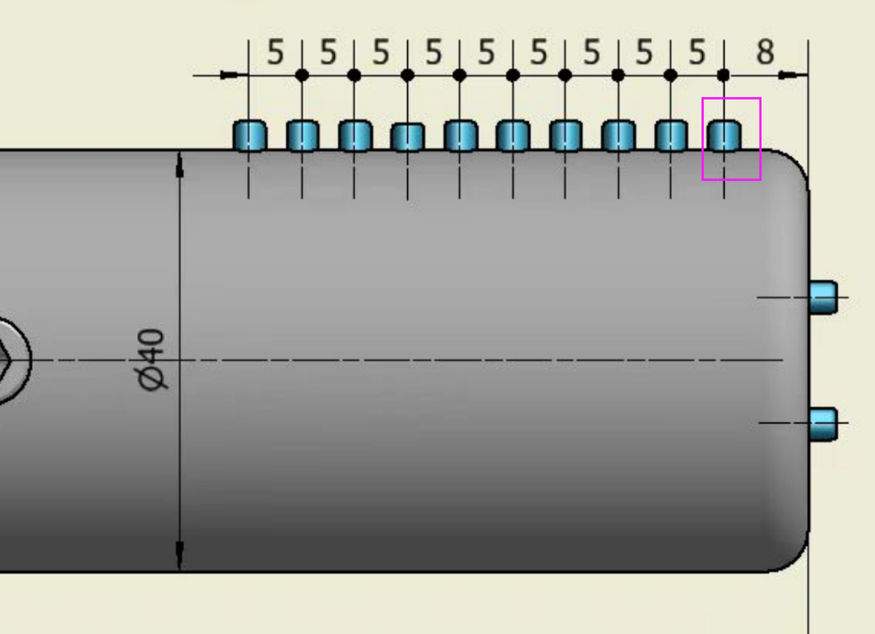
EAST Experiments
Installed, some data obtained
4.5

Slide 53
Outline
Transport and anomalous transport
Biasing experiment on STOR-M
Conventional signal analyses (examples from STOR-M)
Nonlinear signal analyses
Algorithm
Numerical Validation
experiments on STOR-M
Experiments on TJ-II
Experiments on EAST
Other experiments?

Slide 54

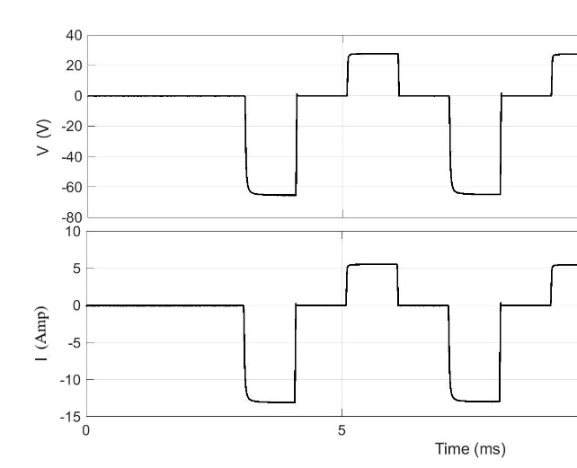
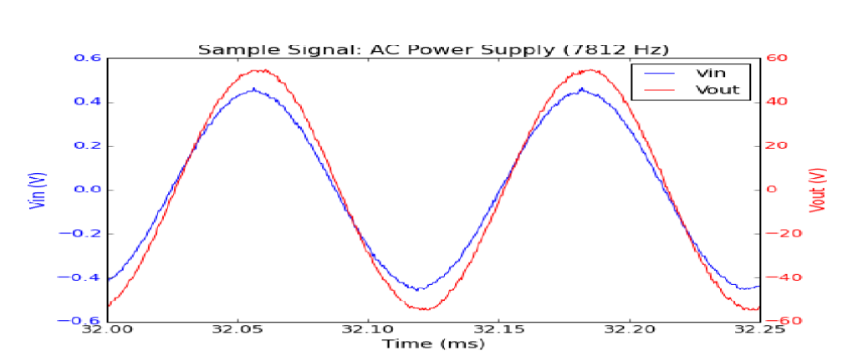
Future Experiments
STOR-M
Small size, flexible device, full control of machine time
Many biasing schemes (DC, AC, bipolar pulsed)
Other H-mode triggering (CT, TH,RMP,…)
J-TEXT, KTX?
1-50 kHz, 120 V

Slide 55
Summary
Transport basics and drift type turbulence presented
STOR-M biasing experiment reviewed
Nonlinear cross-correlation techniques/algorithm introduced with numerical validation and experimental results
Experiments on EAST is ongoing
Further experiments on other machines and for other signals can be explored

Slide 56
Thank you
for your attention!

